Slide 1







GUESS WHO
Women in the Spotlight

Slide 2
In the following slides, you’ll see images of some amazing women - some you may recognise, and some you may not.
Raise your hand if you know who they are! Let’s see how many you can get...

Slide 3
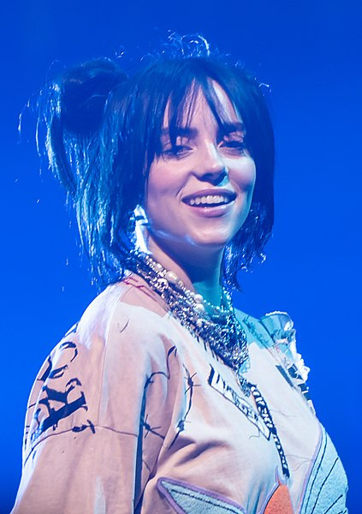
Billie Eilish
Singer, known for hits like "Bad Guy" and "Happier Than Ever.
By Raph_PH, licensed under Creative Commons Attribution 2.0 Generic, via Wikimedia Commons.

Slide 4
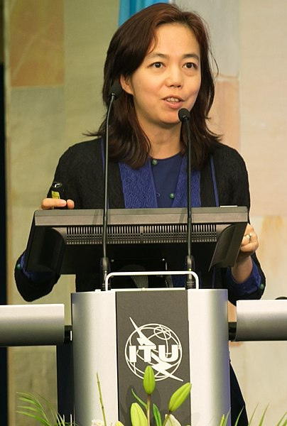
Fei-Fei Li
AI pioneer and computer scientist, known for her work in artificial intelligence and computer vision.
By ITU Pictures, licensed under Creative Commons Attribution 2.0 Generic, via Wikimedia Commons.

Slide 5
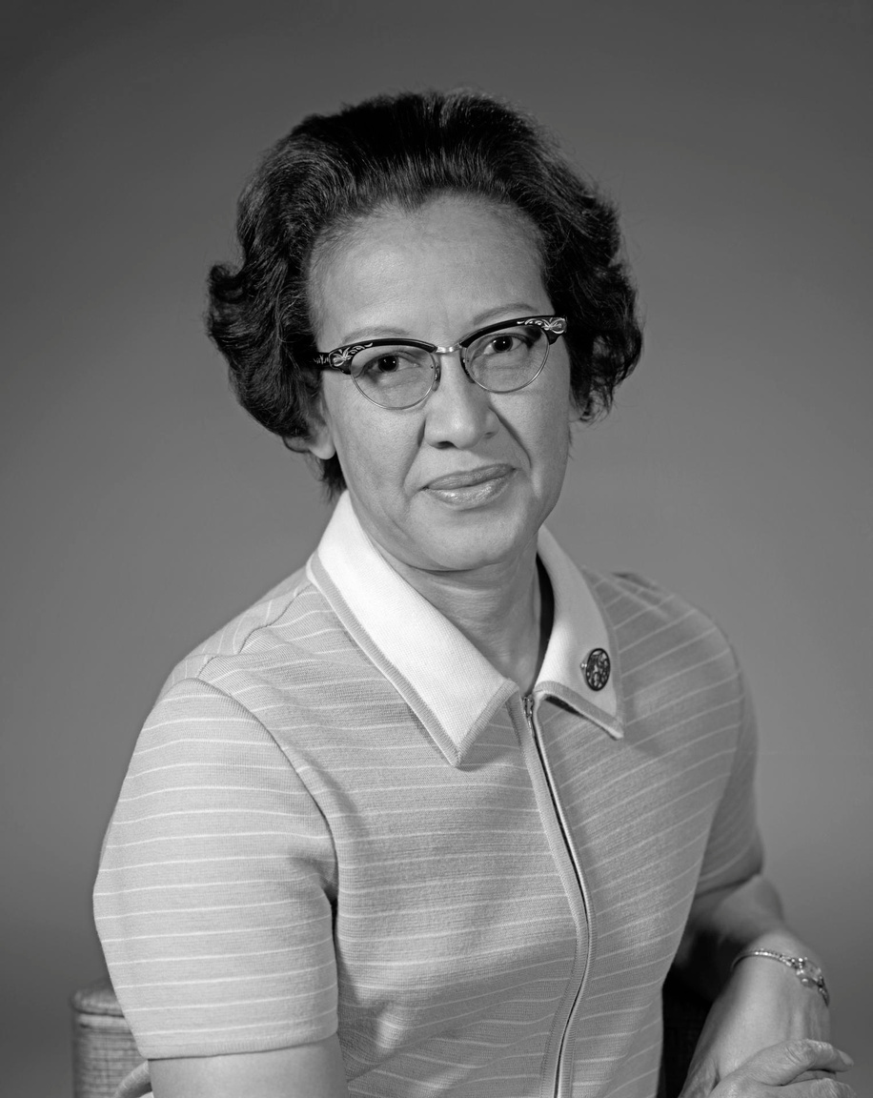
Katherine Johnson
NASA mathematician, whose calculations were critical for the first U.S. spaceflights (featured in Hidden Figures).
By NASA Goddard Space Flight Center, licensed under CC BY 2.0

Slide 6
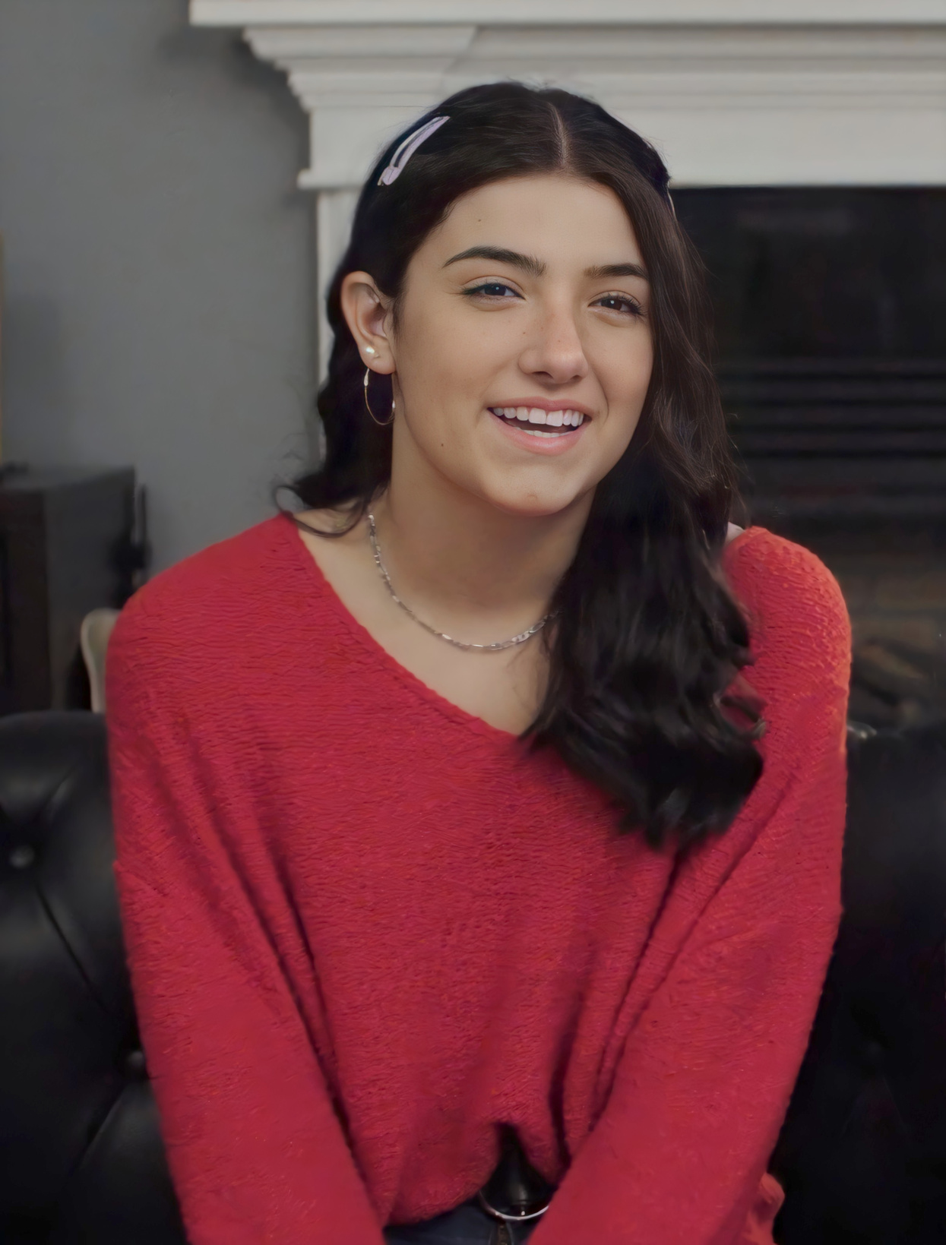
Charlie D’Amelio
TikTok star and social media personality, known for her dance videos.
By Priyanka Pruthi, licensed under CC BY 3.0

Slide 7
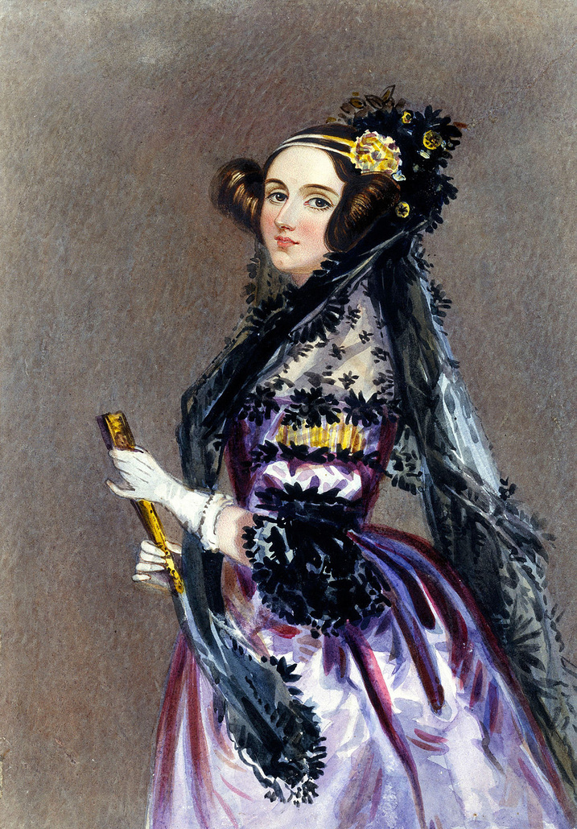
Ada Lovelace
Mathematician, known as the world's first computer programmer.
By Science Museum Group, licensed under public domain

Slide 8
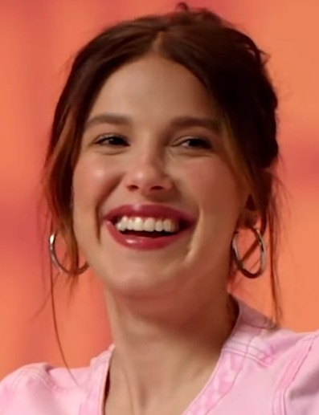
Millie Bobby Brown
Actress, famous for her role as Eleven in Stranger Things.
By VOGUE Taiwan, licensed under Creative Commons Attribution 3.0 Unported, via Wikimedia Commons.

Slide 9
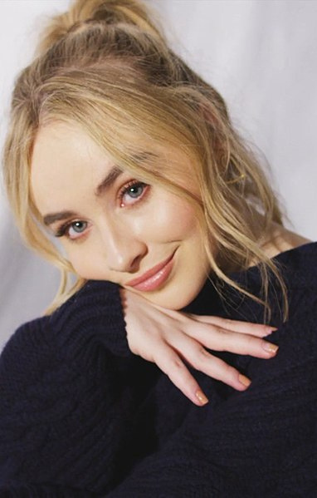
Sabrina Carpenter
Singer and actress, starred in Girl Meets World and has a successful music career.
By Phillip Mansfield, licensed under Creative Commons Attribution 3.0 Unported, via Wikimedia Commons.

Slide 10
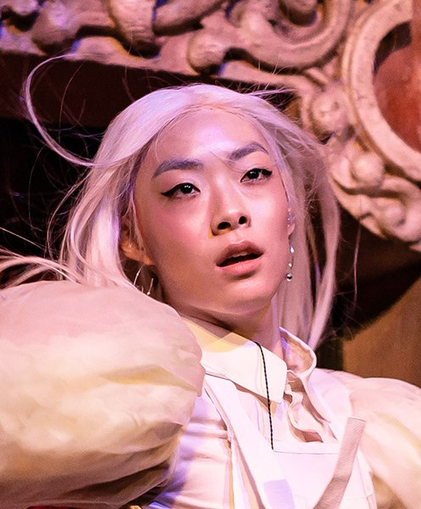
Rina Sawayama
Singer and model, known for her unique blend of pop and social activism through her music.
By Justin Higuchi, licensed under Creative Commons Attribution 2.0 Generic, via Wikimedia Commons

Slide 11
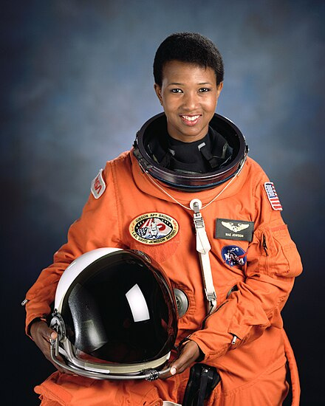
Mae Jemison
Engineer, physician, and the first African American woman to travel in space.
By NASA Image and Video Library, licensed under public domain

Slide 12
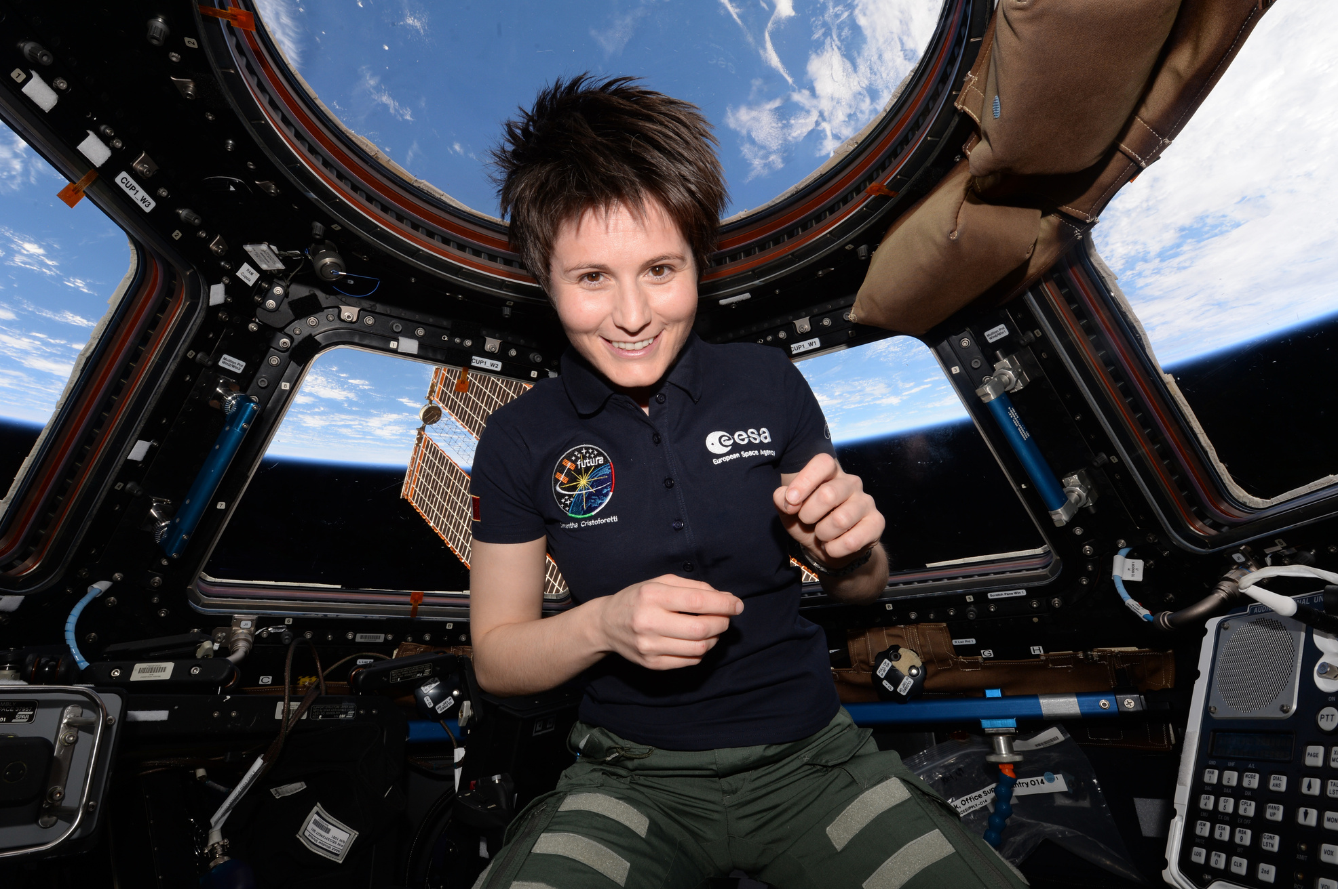
Samantha Cristoforetti
European Space Agency astronaut and aerospace engineer, holds the record for the longest uninterrupted spaceflight by a European astronaut.
By ESA/NASA, licensed under CC BY-SA 3.0 IGO

Slide 13
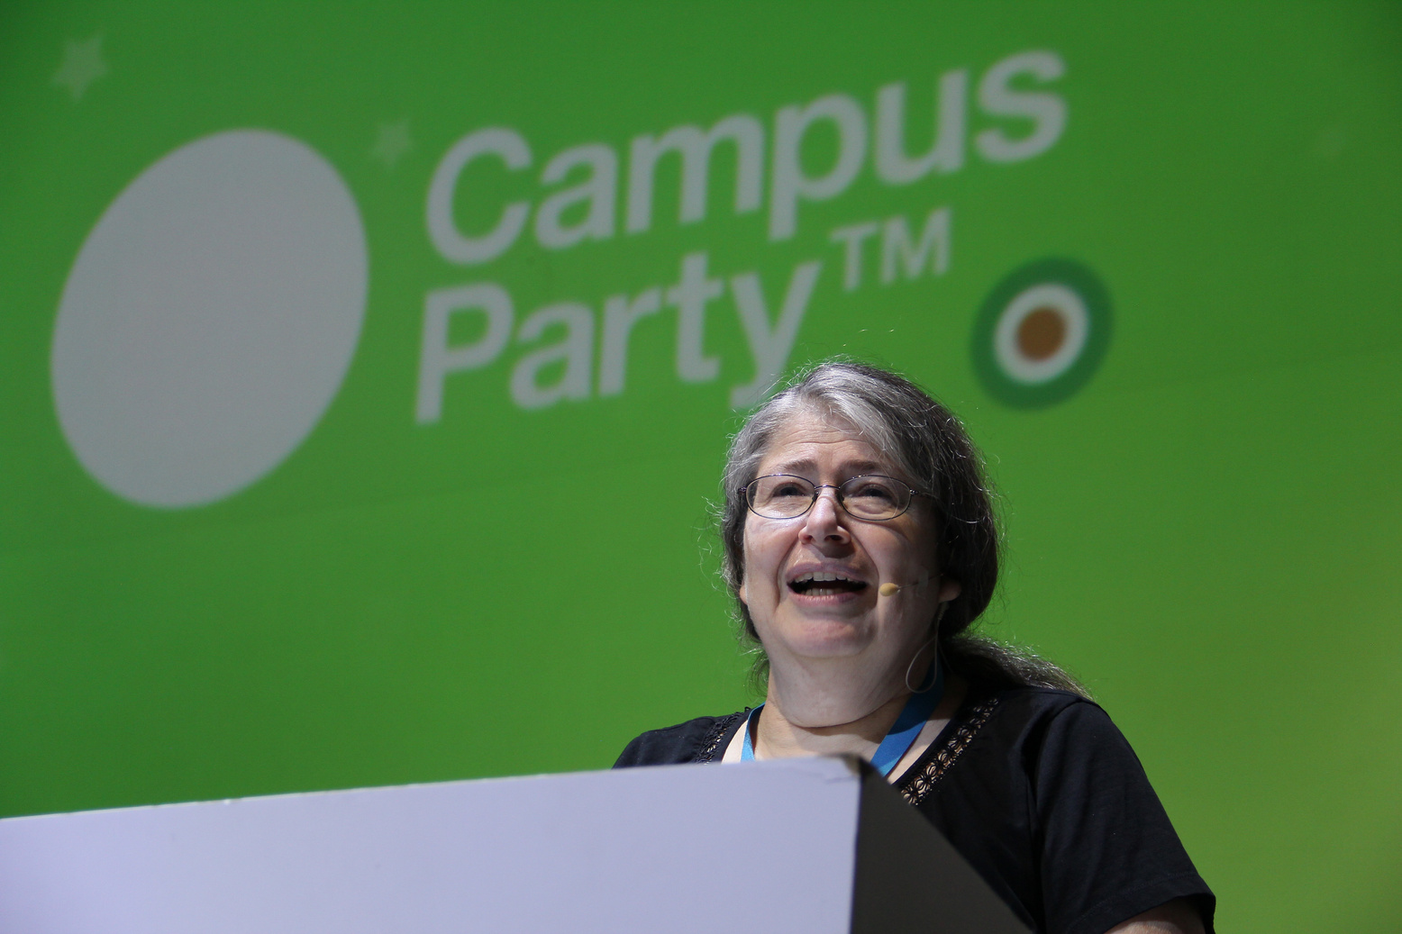
Radia Perlman
Network engineer and computer scientist, often referred to as the “Mother of the Internet” for her work in creating network protocols.
By Campus Party México, licensed under Creative Commons Attribution 2.0 Generic

Slide 14
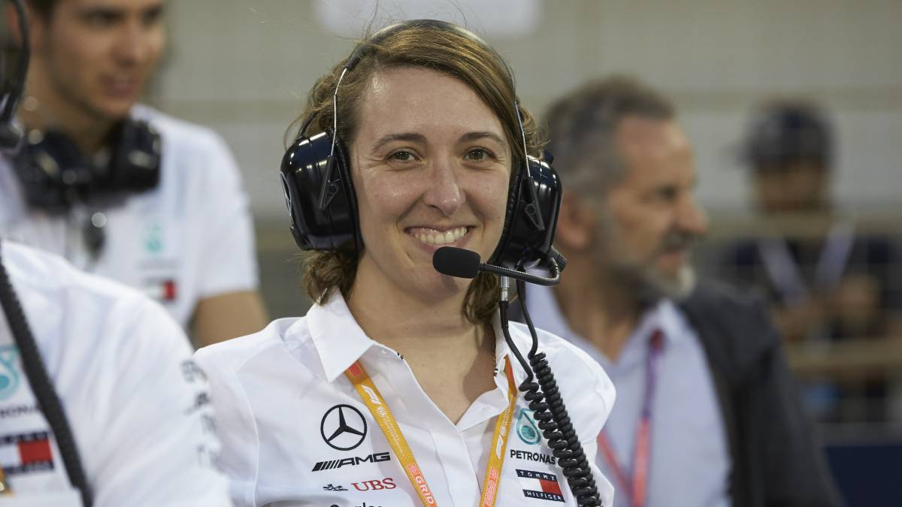
Margarita Torres Díez
Engine Engineer and Formula 1 Engine Test Engineer. for Renault Sport Racing
Trackside F1 Power Unit Engineer at Mercedes.
By AS.com

Slide 15

Ana Taylor-Joy
Actress famous for her role in The Queen’s Gambit.
By Condé Nast (through Vogue Taiwan), licensed under CC BY 3.0

Slide 16
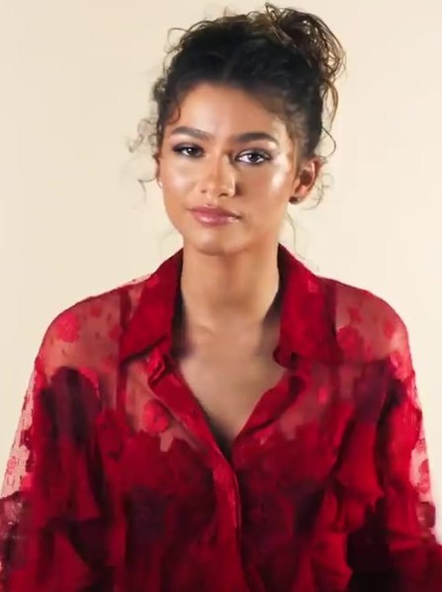
Zendaya
Actress and singer, known for roles in Spider-Man movies and Euphoria.
By Condé Nast (through Vogue Taiwan), licensed under Creative Commons Attribution 3.0 Unported, via Wikimedia Commons

Slide 17
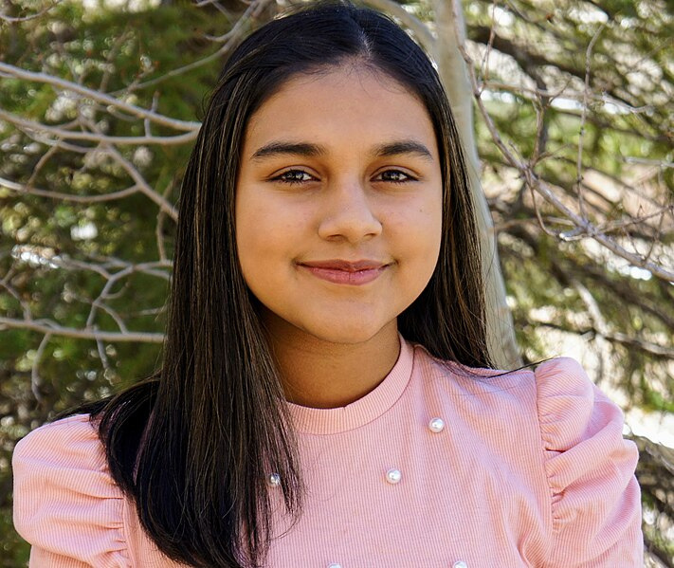
Gitanjali Rao
Teen scientist and inventor, TIME’s Kid of the Year 2020, known for her innovations in water quality testing and cyberbullying detection.
By Ramachb licensed under Creative Commons Attribution-Share Alike 4.0 International, via Wikimedia Commons.

Slide 18
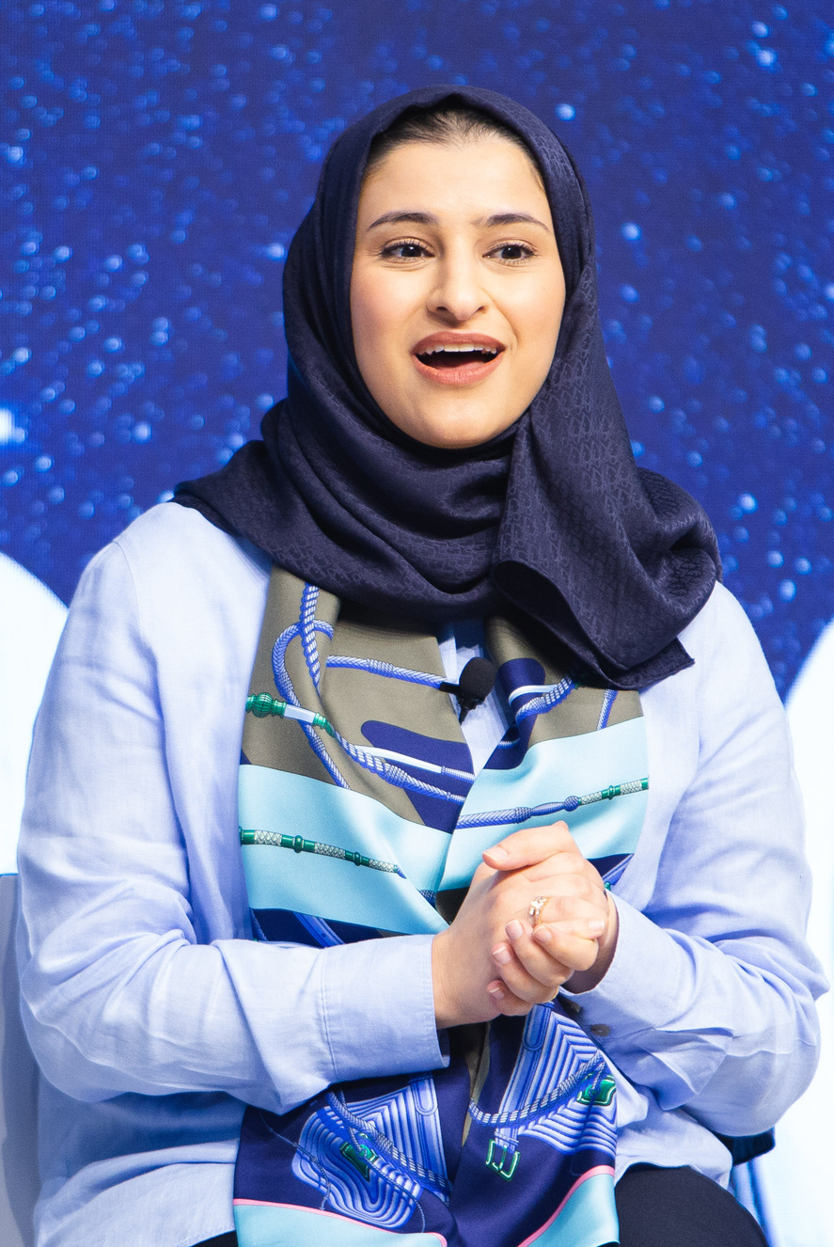
Sara Al Amiri
Former Minister of State for Advanced Technology within the Ministry of Industry and Advanced Technology in the United Arab Emirates (UAE) government. Current Minister of Education, chair of the UAE Space Agency, and Deputy Project Manager of the Emirates Mars Mission.
By Sikarin Fon Thanachaiary - Foundations World Economic Forum - licensed under CC BY 2.0

Slide 19


What Do We Learn From These Inspiring Women? let’s discuss...

Slide 20

The world is full of incredible women – in every field, from entertainment to science and beyond. Whether they're singers or scientists, they all broke barriers to become who they are today.
STEM careers might not always be in the spotlight, but they can change the world. Let’s keep that in mind as we explore more about how STEM can shape your future!

